Slide 1
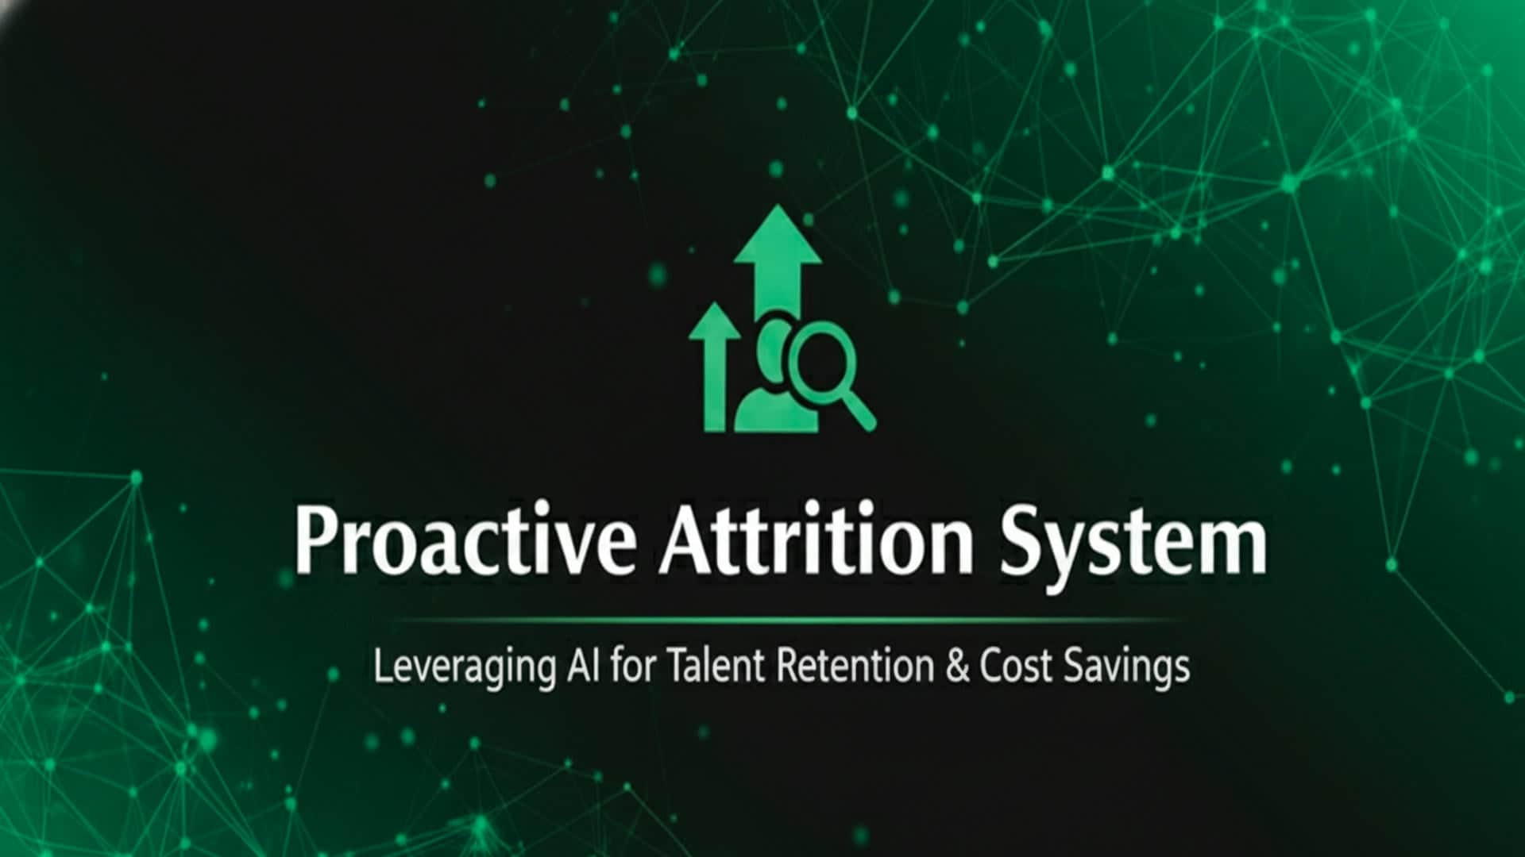



DR 𝗠𝗮𝗵𝗺𝗼𝘂𝗱 𝗧𝗮𝗹𝗮𝗮𝘁
SUPERVISED BY

Slide 2

Contents
INTRODUCTION
PROBLEM STATEMENT
1
2
RELATED WORK
PROPOSED SOLUTION
3
4
METHODOLOGY
CONCLUSION
5
6

Slide 3
Introduction

Slide 4

Data science
Data science is the process of turning messy, raw data into clear, valuable insights by finding hidden patterns and trends, allowing for smarter, more informed decisions

Slide 5
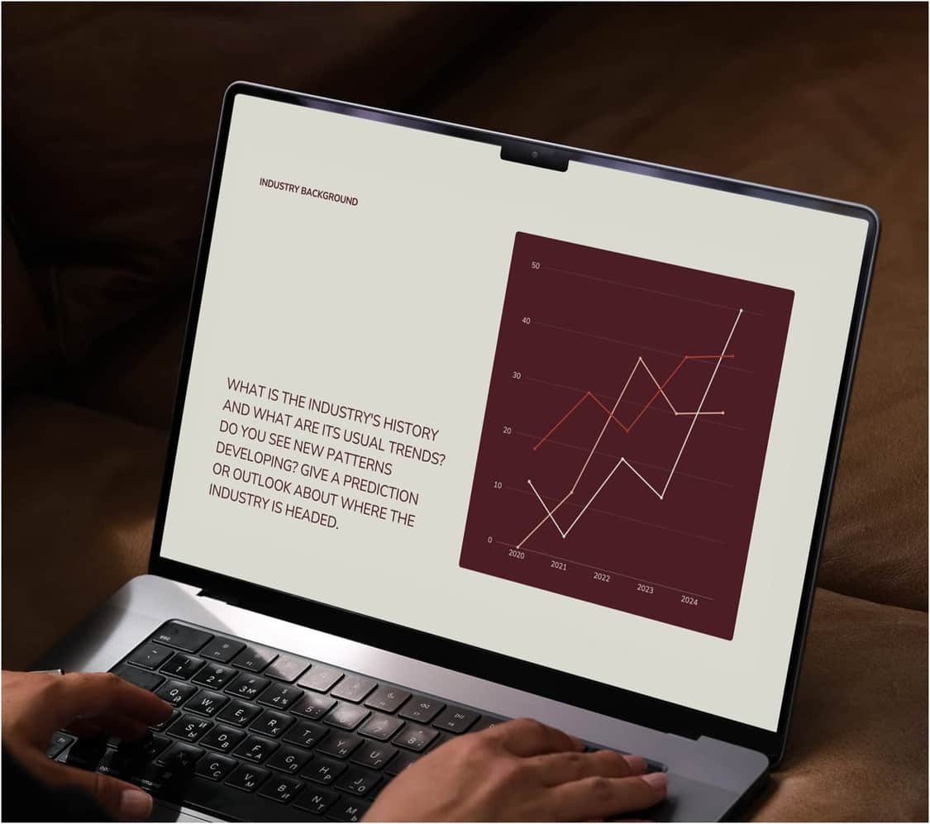
Machine Learning
Machine Learning (ML) trains algorithms to learn patterns from data for predictions. As the core of data science, it automates the process of transforming raw information into valuable insights.

Slide 6
Problem Statement

Slide 7

EMPLOYEE ATTRITION
THE PERSISTENT AND OFTEN SUDDEN LOSS OF TALENT (EMPLOYEE ATTRITION) IS A MAJOR, RECURRING FINANCIAL AND OPERATIONAL RISK FOR ORGANIZATIONS GLOBALLY AND ACROSS ALL MARKET CYCLES. THIS TURNOVER DRIVES UP DIRECT COSTS (RECRUITMENT, TRAINING) WHILE SIMULTANEOUSLY CAUSING A CRITICAL EROSION OF EXPERTISE AND TEAM MORALE. THEREFORE, THERE IS A FUNDAMENTAL NEED FOR COMPANIES TO EMPLOY PREDICTIVE ANALYTICS TO QUICKLY AND ACCURATELY FORECAST WHICH EMPLOYEES ARE LIKELY TO LEAVE, ENABLING THE IMPLEMENTATION OF TARGETED AND TIMELY RETENTION STRATEGIES TO SECURE ESSENTIAL HUMAN CAPITAL.

Slide 8
RELATED WORK

Slide 9
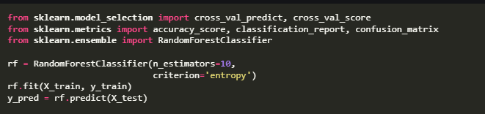
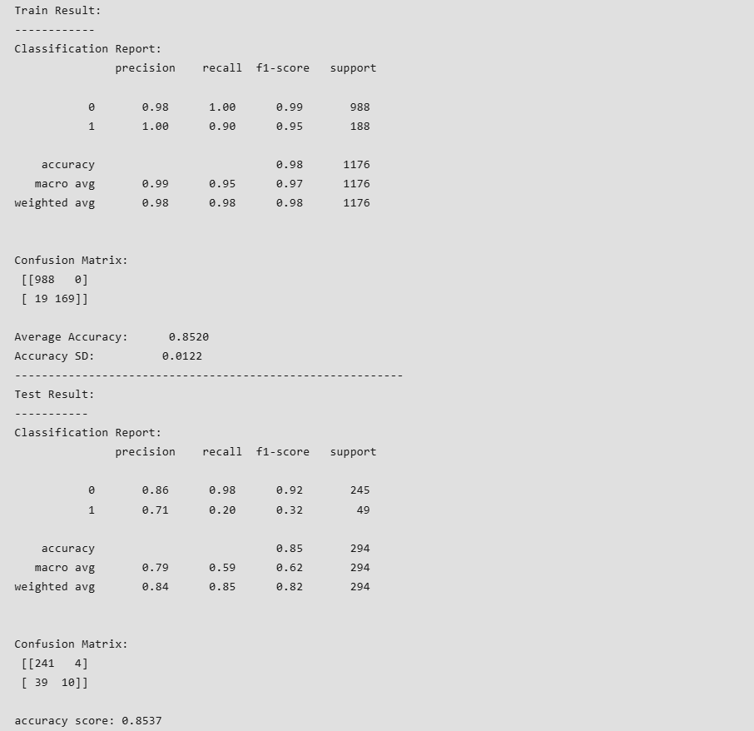
Using random Forest classifier
on IBM HR Analytics Employee Attrition & Performance
We use the IBM HR Analytics Employee Attrition & Performance dataset as a benchmark because it shares the same 35 features as our data. However, previous studies using the IBM dataset are limited by its small size 1,470 samples. Our research uses a much larger dataset, approx 250,000 samples. This high volume of data reduces the chance of overfitting and lets us find more complex, general patterns that are not detectable in the smaller benchmark.
While using tree models Random Forest models show decent accuracy ranges from 65% to 85% on the IBM Attrition data, this is misleading due to the severe class imbalance. The critical F1-Score often remains very low, around 32%. To properly address this, we used a more advanced model, XGBoost, combined with the imbalanced data technique SMOTE (Synthetic Minority Over-sampling Technique). This approach ensures reliable prediction across both attrition and non-attrition classes

Slide 10
PROPOSED SOLUTION

Slide 11
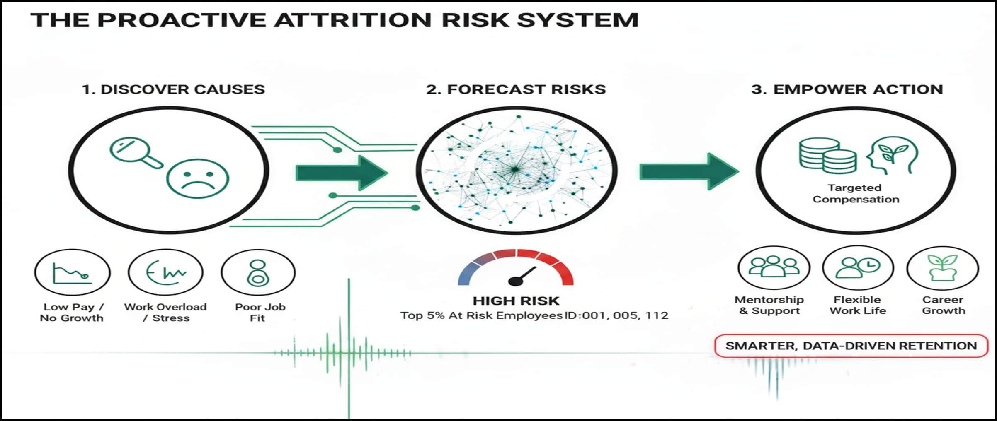
THIS SOLUTION LEVERAGES MACHINE LEARNING TO TRANSFORM THE COMPANY'S APPROACH TO TALENT RETENTION FROM REACTIVE TO PROACTIVE USING PREDICTIVE ML MODELS.

Slide 12
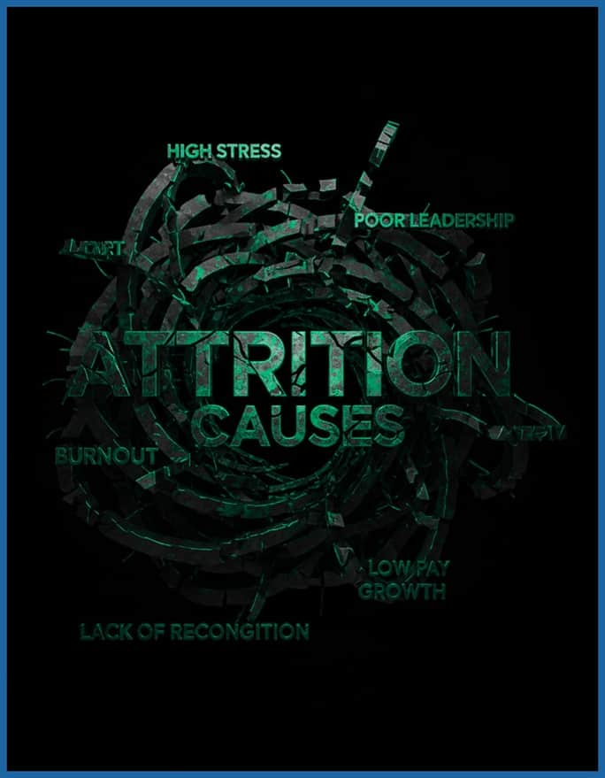
Discover causes
The foundation of our system is the continuous monitoring of key organizational and employee features. By actively tracking how variables like income, Work-life balance, and Job level change over time, we identify and prioritize the factors that most increase the likelihood of employee attrition. This diagnostic approach ensures our interventions are always based on the most current and relevant causes

Slide 13
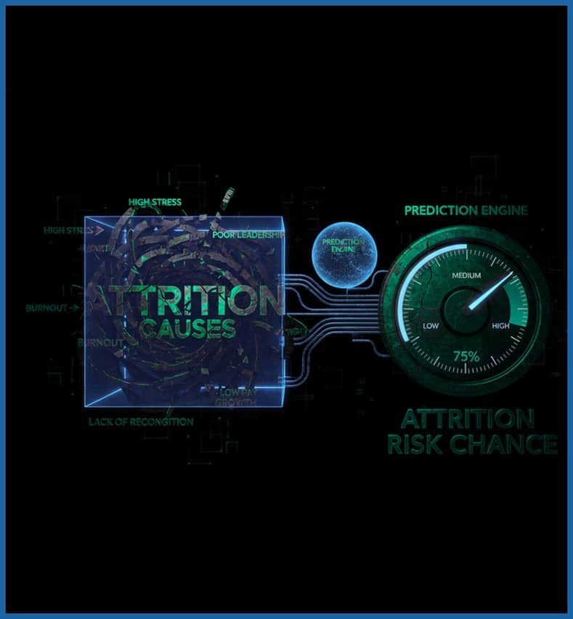
Forcast Risks
This is the predictive stage, where the discovered causes are fed into a ML model to Predict and Quantify Attrition Likelihood viewed in percent as we will see in the deployment later on

Slide 14

Empowering Actions
This is the categorization stage where high attrition risk employees are segmented into groups based on their underlying risk profile factors (Career Status, Mobility Obligations, and Logistical Burden), allowing for the creation of targeted retention strategies for each distinct segment

Slide 15
METHODOLOGY

Slide 16
BUSINESS UNDERSTANDING
1
DATA COLLECTION
2
Encoder phase
PREPROCESS DATA
3
EXPLORATORY DATA ANALYSIS (EDA)
4
Supervised / unsupervised
Labels / clustering
MODELING
5
Decoder phase
MODEL EVALUATION
6
DEPLOYMENT
7

Slide 17

STEP 1: BUSINESS UNDERSTANDING
📉
PROBLEM STATEMENT
Unexpected talent loss creates immediate financial strain (recruitment costs) and operational risks through knowledge erosion.
🎯
PROJECT OBJECTIVE
Deploy predictive analytics to forecast high-risk employees shifting HR strategy from reactive to proactive
Achieve a Model Recall of >80% to capture the majority of potential exits and reduce annual turnover costs by 15%

Slide 18

STEP 2: DATA COLLECTION
DATA SOURCE
Our data is synthetic based on the famous IBM attrition hr data set but with 249636 samples instead of 1470 sample in the original to simulate realistic organizational dynamics allowing us to.
🛡️PRIVACY & VALIDATION
This approach allows us to validate our "Predict & Quantify" engine logic and test segmentation strategies without exposing sensitive employee info
📊 KEY FEATURES TRACKED
The dataset encompasses critical features to attrition such as Monthly Income, Job Level, demographics and Work-Life Balance

Slide 19
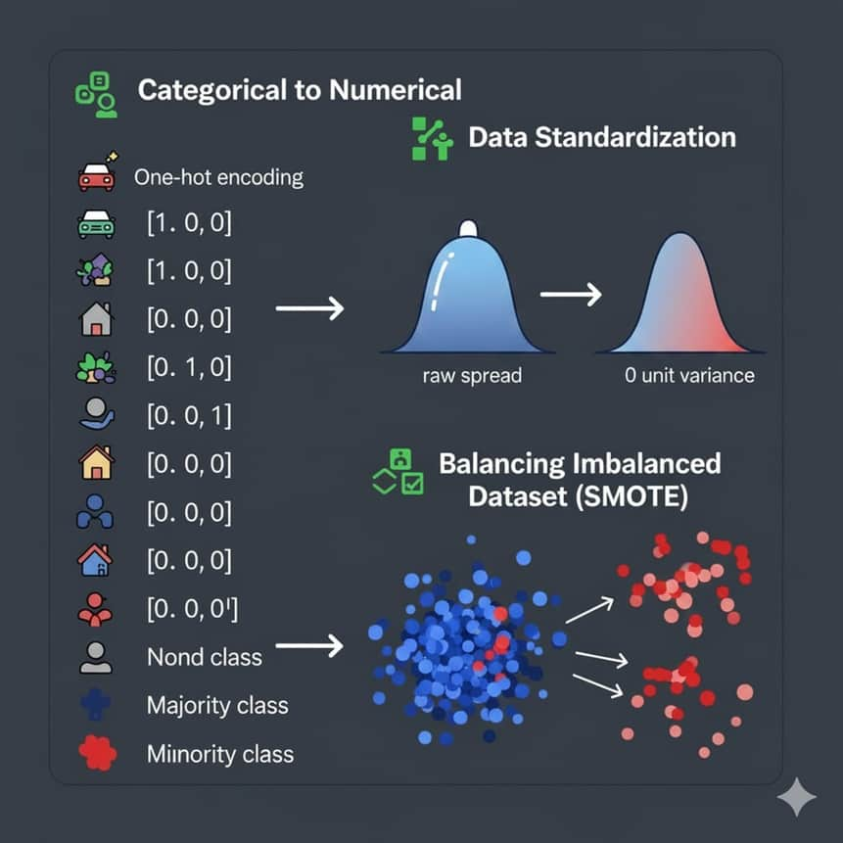
STEP 3: DATA PROCESSING
CATEGORICAL ENCODING
Qualitative variables (e.g., BusinessTravel, Department) are converted into numerical vectors to ensure compatibility with machine learning algorithms.
FEATURE SCALING (ONLY ON TRAIN DATA)
We apply standardization to features with vast ranges (e.g., Monthly Income vs. Job Level) to prevent bias and improve model convergence speed.
ADDRESSING CLASS IMBALANCE (ONLY ON TRAIN DATA)
ATTRITION IS A RARE EVENT (~13% OF DATA). WE IMPLEMENT TECHNIQUES LIKE SMOTE (SYNTHETIC MINORITY OVER-SAMPLING) TO PREVENT THE MODEL FROM IGNORING HIGH-RISK EMPLOYEES.

Slide 20
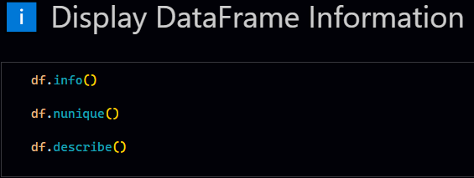
STEP 4: DATA ANALYSIS
Before training a machine learning model, utilizing key commands for Exploratory Data Analysis (EDA) is crucial for proper data preparation:
1- df.info(): Provides a high-level overview of the dataset's structure, showing column data types and non-null values.
2- df.nunique(): Counts the unique values in each column, helping to assess the usefulness and cardinality of features.
3- df.describe(): Generates a statistical summary of numerical columns, including the mean, standard deviation, and range, which is vital for understanding data distribution and detecting outliers.

Slide 21
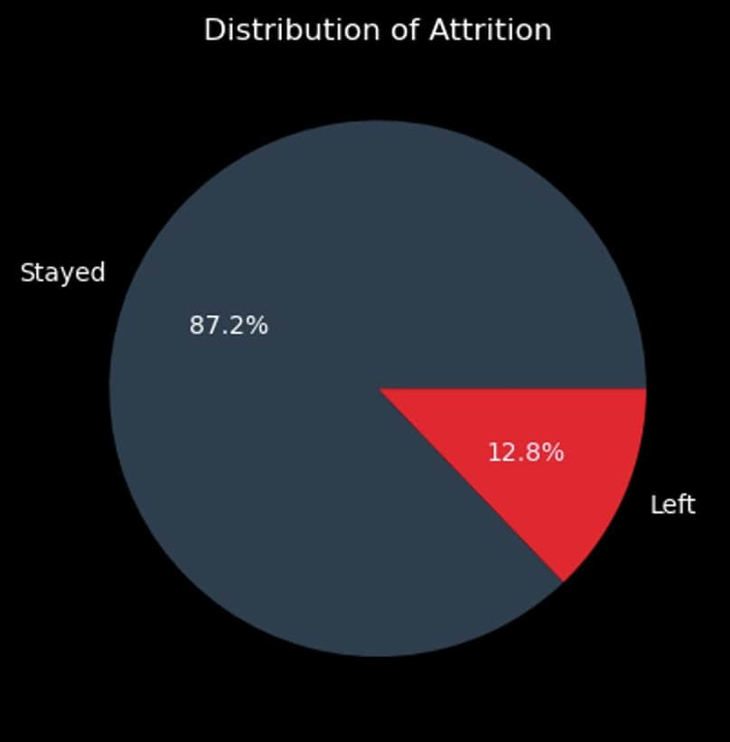
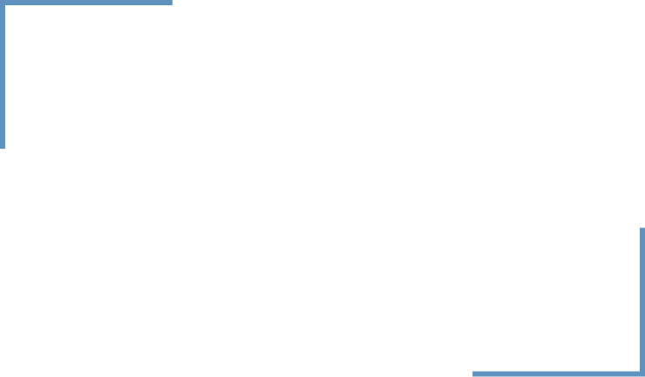
VISUALIZATON
THE PIE CHART REVEALS A SEVERE CLASS IMBALANCE IN THE DATASET. A LARGE MAJORITY OF EMPLOYEES, 87.2%, STAYED, WHILE ONLY 12.8% LEFT (ATTRITION).

Slide 22
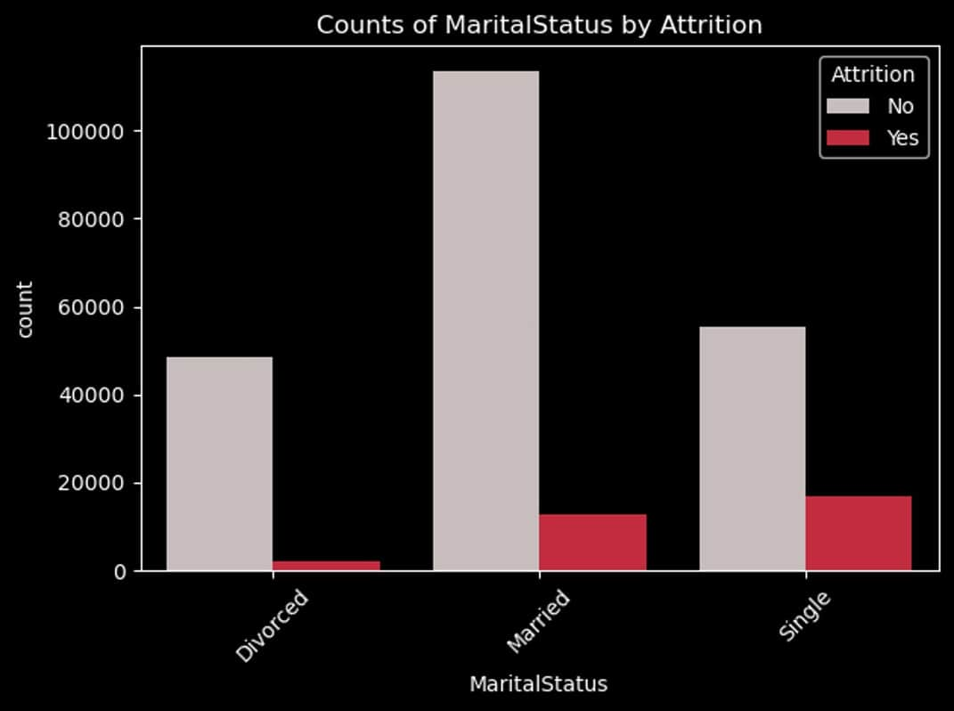
VISUALIZATON
Single employees showing the highest propensity to leave this may be because of lack of obligations or ambitions for growth

Slide 23
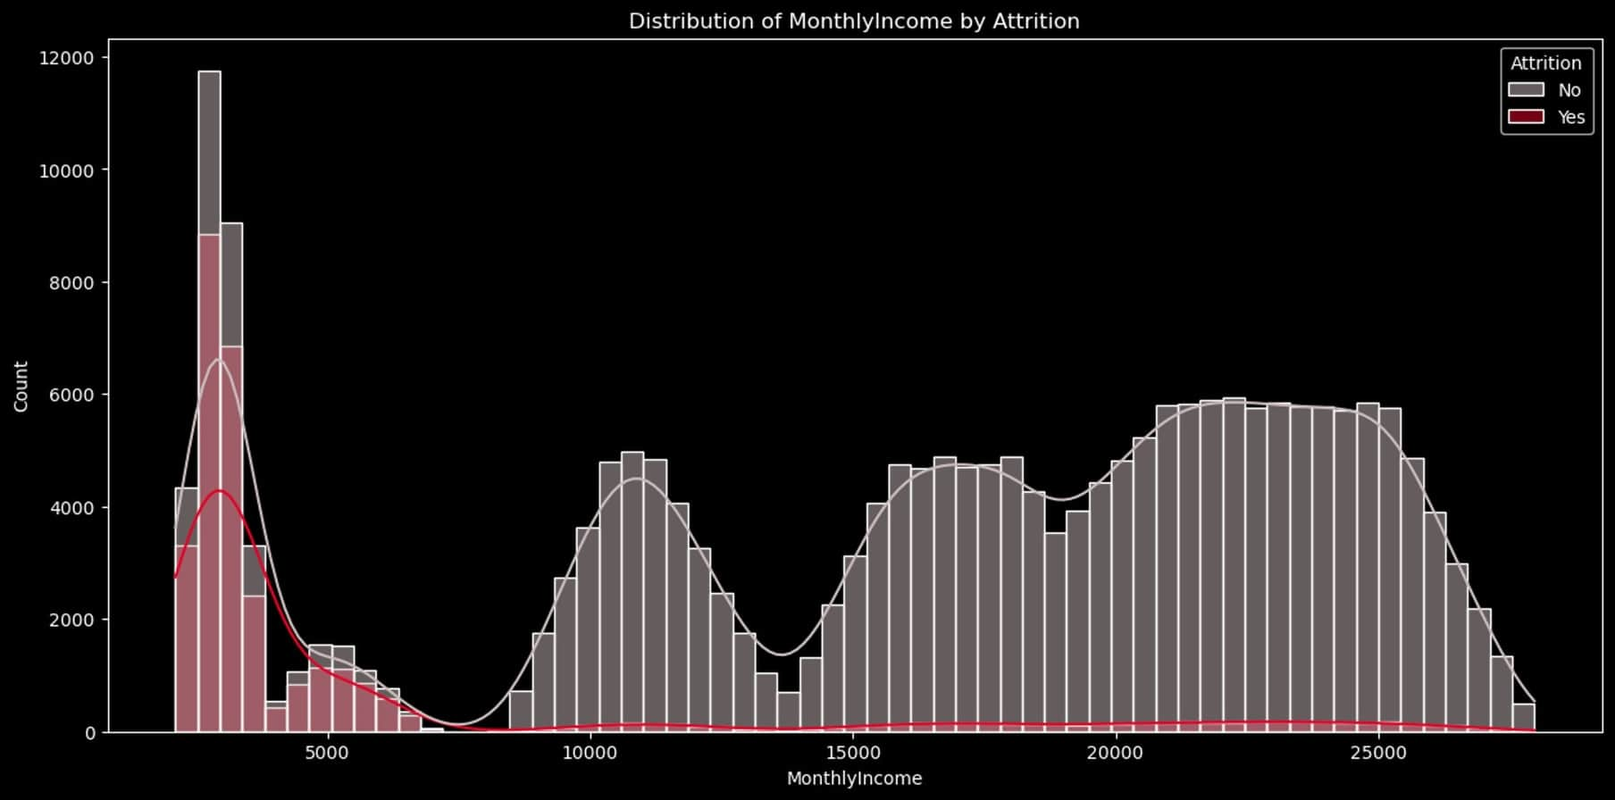
The distribution of Monthly Income by Attrition reveals that Monthly Income is a critical factor driving employee turnover.
High Attrition at Low Income: The vast majority of attrition concentrated within the lowest income
Low Attrition at High Income: As income increases, the attrition rate drops sharply. Employees in the mid-to-high income

Slide 24
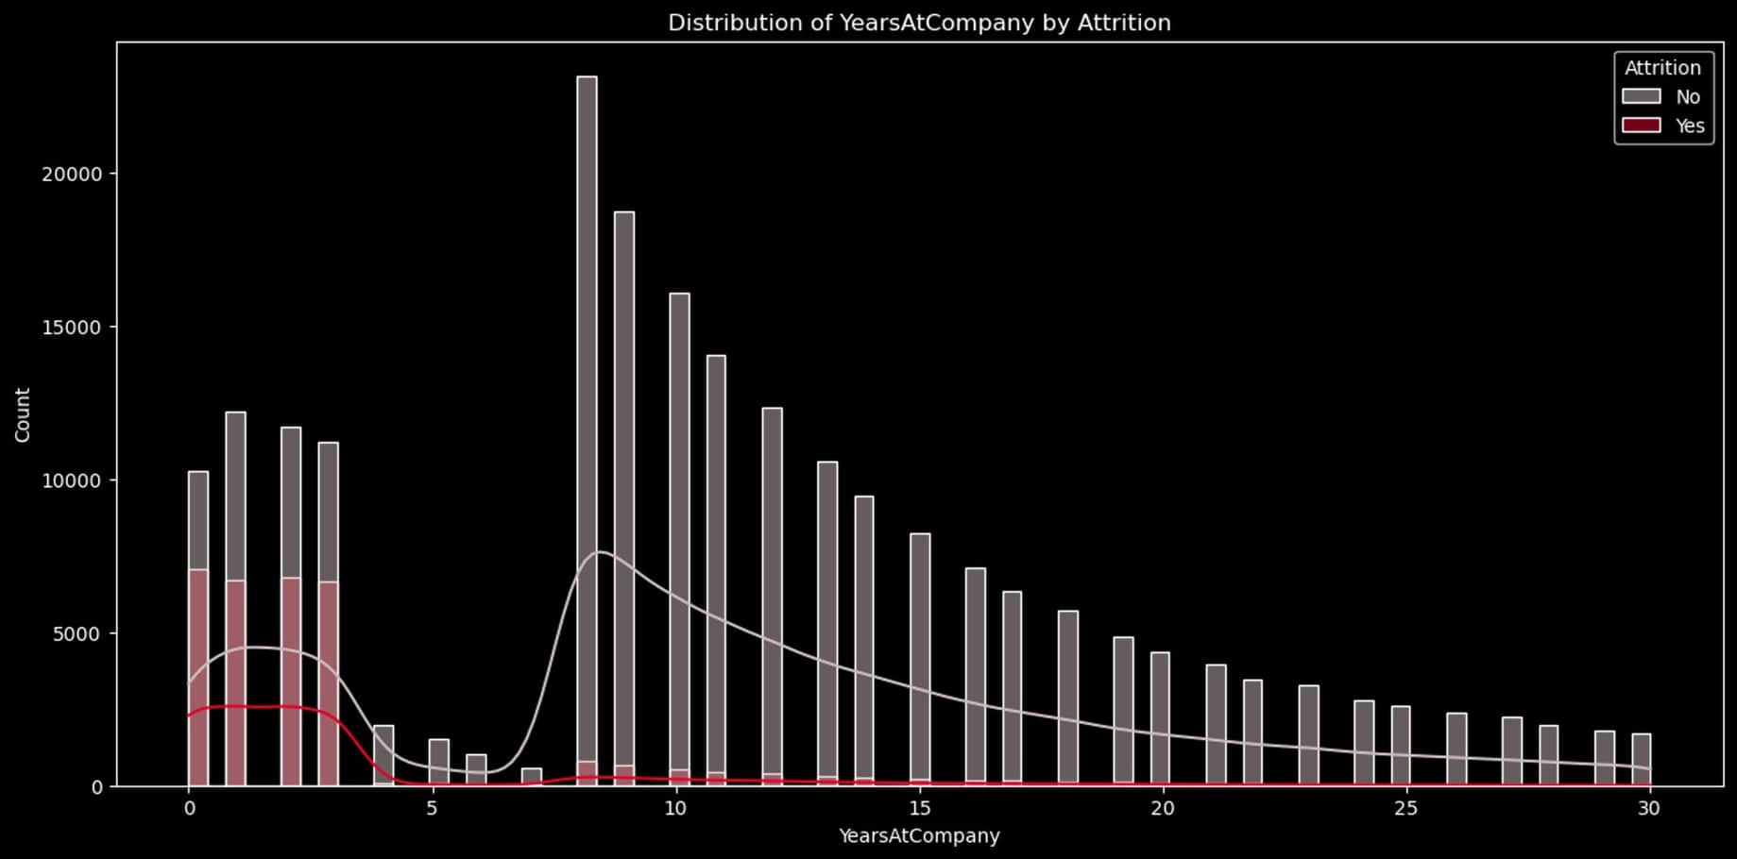
Highlights the critical role of tenure in employee retention: Attrition is a Low-Tenure Risk: The vast majority of employee attrition (red bars) occurs within the first 1 to 3 years of service.

Slide 25
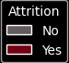
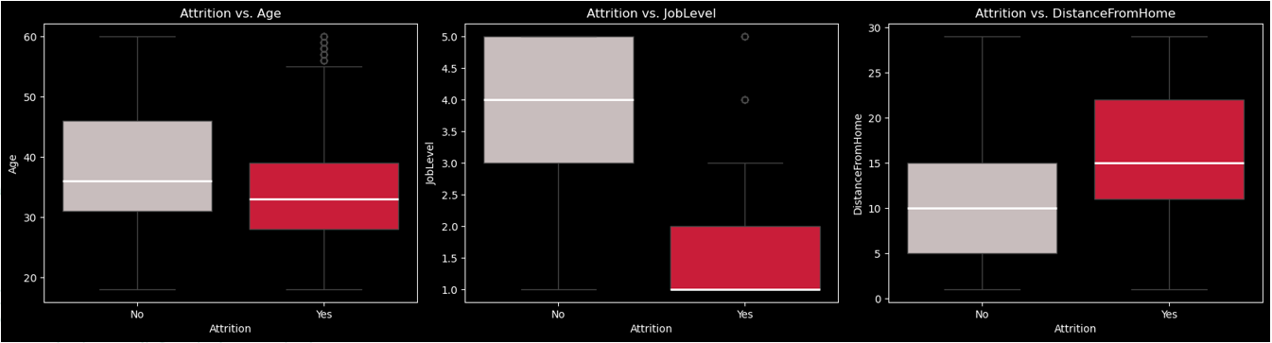
While most attrition is driven by younger employees, these older exits suggest that turnover can still occur across the full age spectrum, potentially due to factors like early retirement or unique organizational changes.
Attrition risk is overwhelmingly concentrated at the lowest job levels from level 1 to level 3.
Employees who live farther from the work place are at higher risk of attrition.

Slide 26
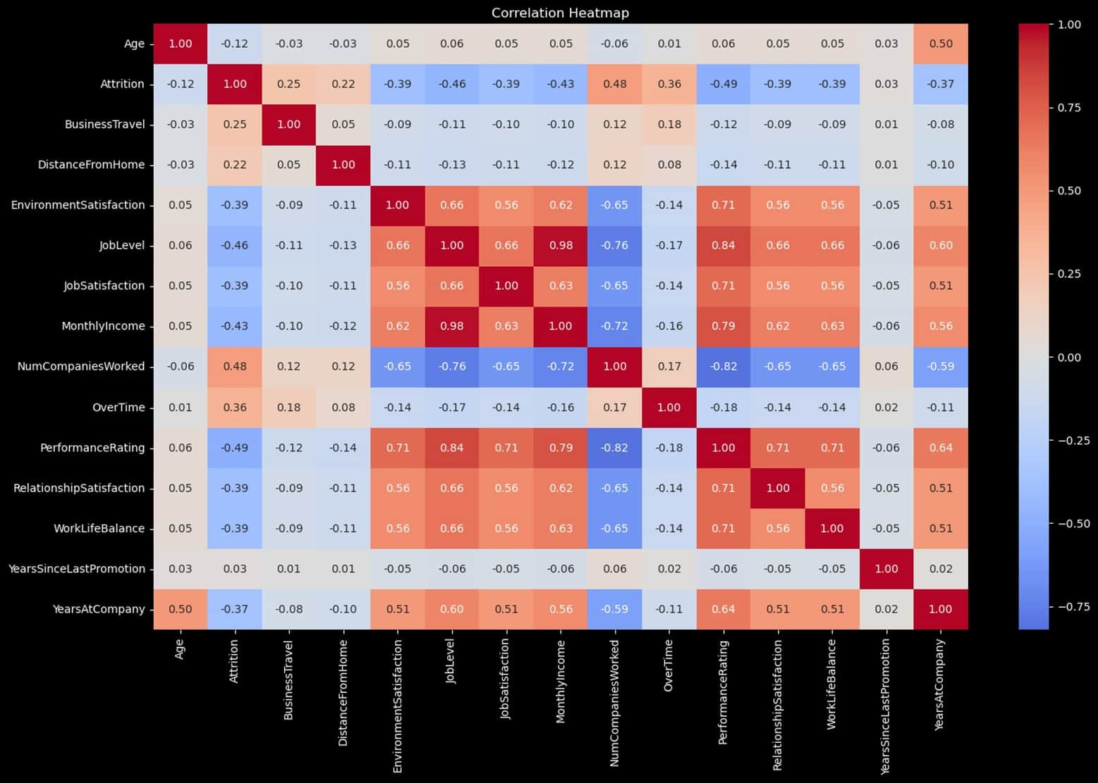
FULL SUMMARY OF ALL FEATURES
Most important features to attrition based on correlation
1- PERFORMANCE RATING
2- NUMBER OF COMPANIES
3- JOB LEVEL
4-MONTHLY INCOME
5-SATISFACTON FEATURES
6-TRAVEL / DISTANCE FEATURES

Slide 27
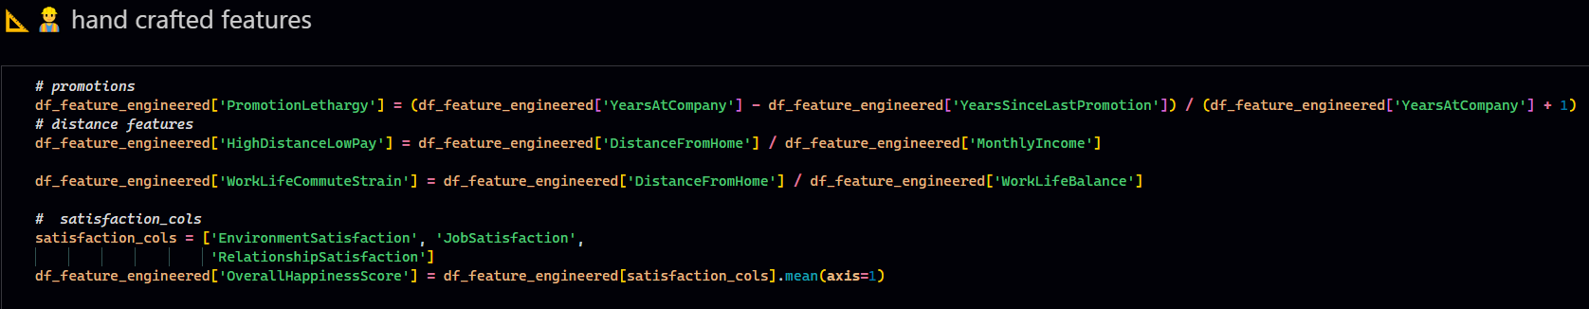
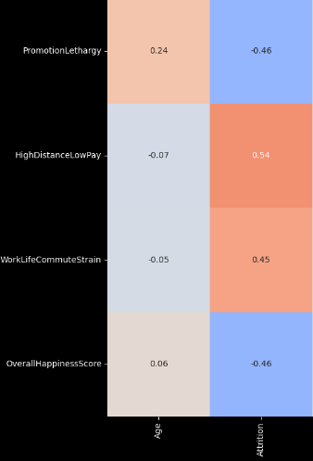
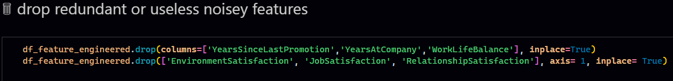
Feature engineering
Following a thorough analysis of employee data, we have gained a comprehensive understanding of attrition characteristics. This insight is crucial for optimal feature engineering and selection, allowing us to discard noise and build powerful features. This disciplined approach guarantees we are training our model on the most relevant data, which is essential for achieving the highest accuracy and the target recall rate.
We now represent our data with less number of stronger features 19 instead of 21

Slide 28
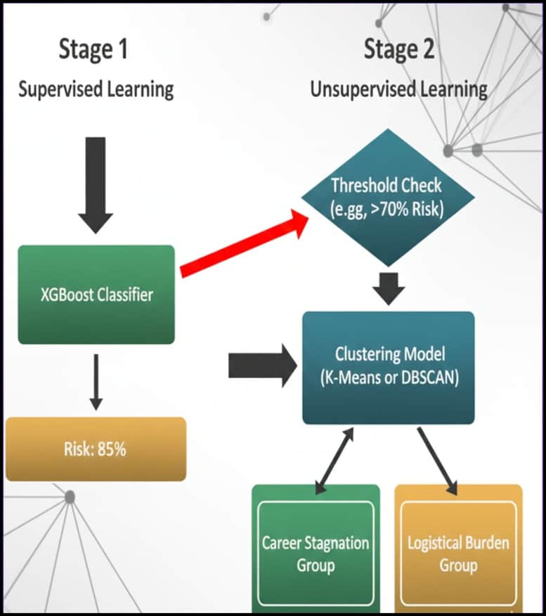
STEP 5 & 6 : MODELING /EVALUATION
We used both supervised and unsupervised learning with variety of techniques like smote PCA grid search and others
First, the supervised model will determine the percent of attrition then if the employee have above a certain threshold he will be passed to the unsupervised model for to be placed in a group
Stage 1: Forecast Risks (Supervised Learning)
Input: feature engineered employee data.
Process: Supervised Model (XGBoost) which predicts the likelihood of leaving.
Output: Employees exit with a "Risk Percentage."
Filter: Only employees above a set threshold (the high-risk segment) are passed through.
Stage 2: Empower Action (Unsupervised Learning)
Input: Only the High-Risk employees.
Process: The clustering visualization represents the Unsupervised Model (K-Means).
Output: The high-risk group is segmented into actionable clusters based on
"Career Status", "Logistical Burden" and “mobility”

Slide 29
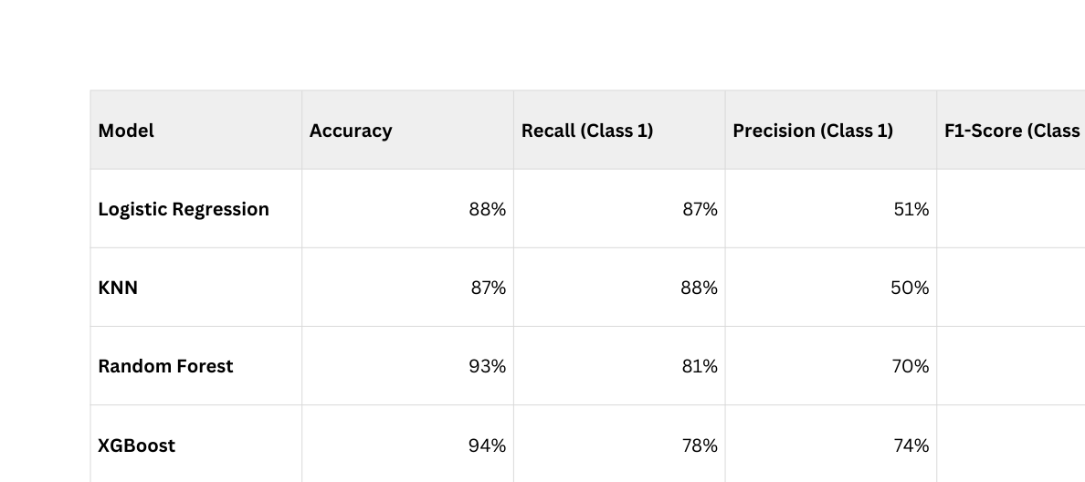
STAGE 1: FORECAST RISKS (SUPERVISED LEARNING)
Baseline models
Before training the models we took a sample(we used sampling to fasten the process of selecting the model) a 5% of our main 250000 dataset , we made sure to apply standardization and smote (SMOTE rebalances an imbalanced dataset by synthetically creating new minority class samples based on existing ones to improve predictive performance) on the train data only to avoid any data leak
WE USED THE BASE MODELS WITHOUT ANY HYPERPARAMETERS FIRST. TARGETING THE TOTAL ACCURACY AND F1 SCORE
1- logistic regression
2- KNN
3- random forest
4-XGBoost
we can notice that XGBoost is taking the lead by a slight 1% in accuracy and f1 score from random forest

Slide 30
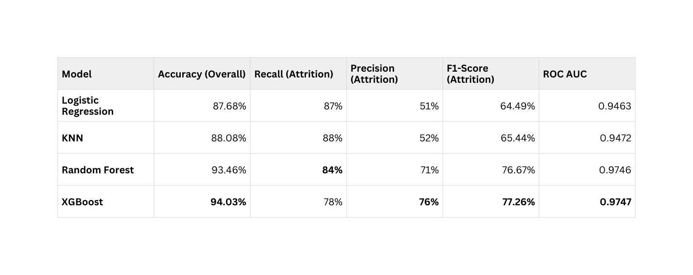
STAGE 1: FORECAST RISKS (SUPERVISED LEARNING)
Tuned models
Then We benchmarked the four initial models again optimized using Grid Search(a technique used to find the best hyperparameter for a model) to ensure peak predictive performance for all the models
Again the XGBoost model takes the lead, making it our chosen model for supervised learning

Slide 31
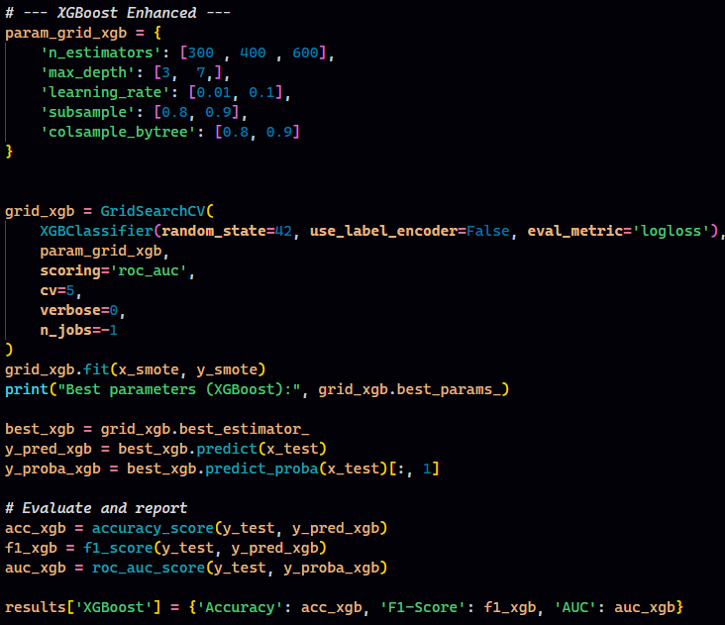
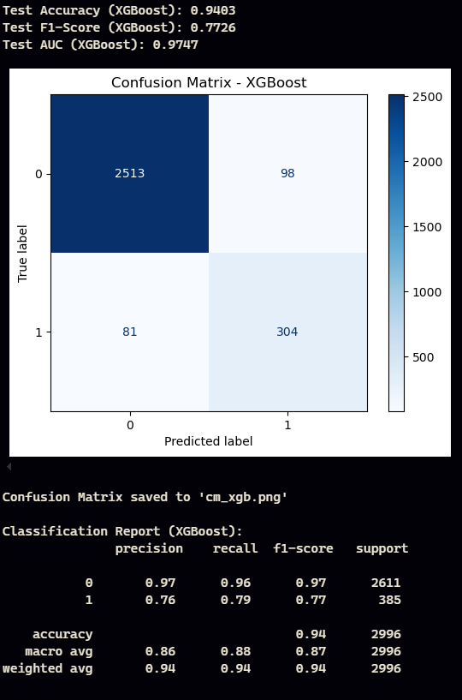
STAGE 1: FORECAST RISKS (SUPERVISED LEARNING)
XGBoost: sample evolution
RESULT

Slide 32
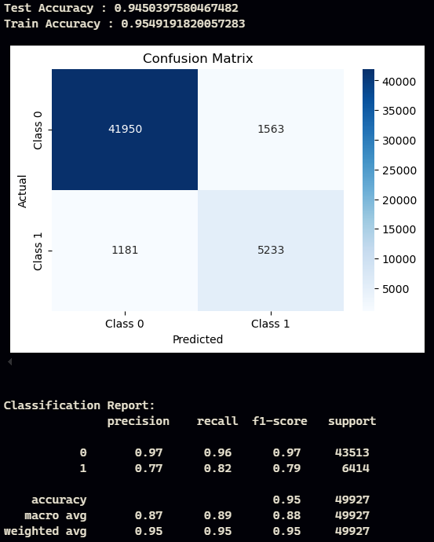
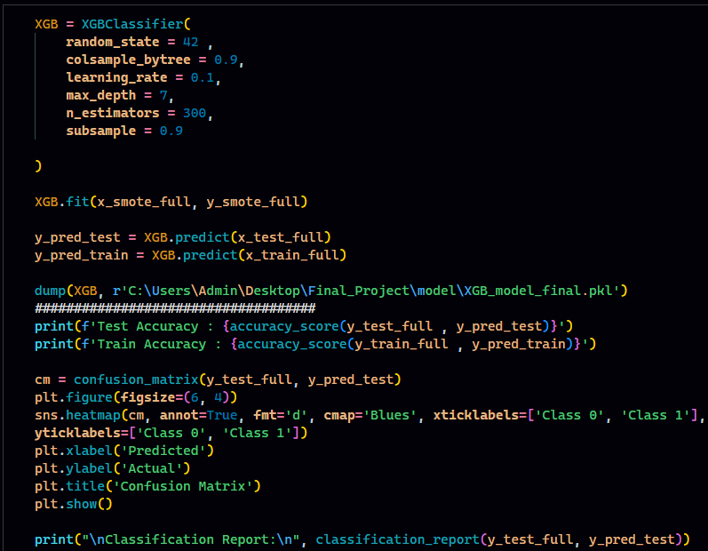
RESULT
XGBoost: model is evaluated on the entire dataset, we have successfully achieved above 80% recall as intended meaning our selected sample is truly representing the population

Slide 33
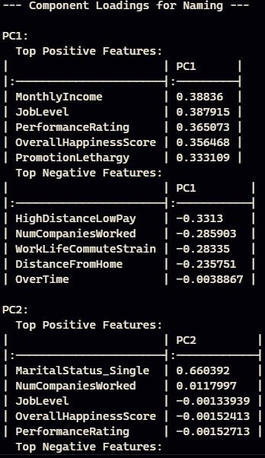
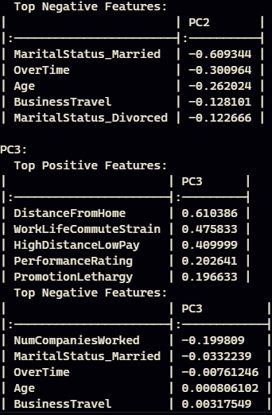
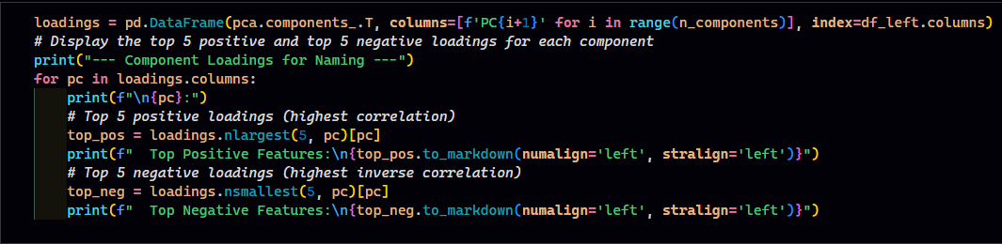
STAGE 2: EMPOWER ACTION (UNSUPERVISED LEARNING)
Code output understating
While we observed a total explained variance of 62.28% in the original data, we did not rely solely on this metric. Instead, our strategy focused on component interpretability:
Solution: We mapped the highest positive and negative correlations between the original features and the new three PCA components.
We successfully defined three components that are heavily weighted by the most critical attrition-driving features (e.g., Monthly Income, Job Level, Years at Company).
Outcome: This ensured that even with reduced total variance, the resulting clusters are named and defined by factors that HR can directly influence
Now it's time to take people with high attrition and cluster them into groups, however before we do this we used PCA( Principal Component Analysis is a statistical technique for dimensionality reduction that converts a large set of correlated variables into a smaller set of uncorrelated "Principal Components" while preserving the maximum amount of original data variation.) on our data to reduce our features to 3 components only giving us the ability to visualize the clusters here we encountered 2 problems
1- the drop in variance of our data after PCA 62.28% variance in the original data
2- naming the PCA components (features) that the clusters will be named according too
Lucky we found a solution in the code below

Slide 34
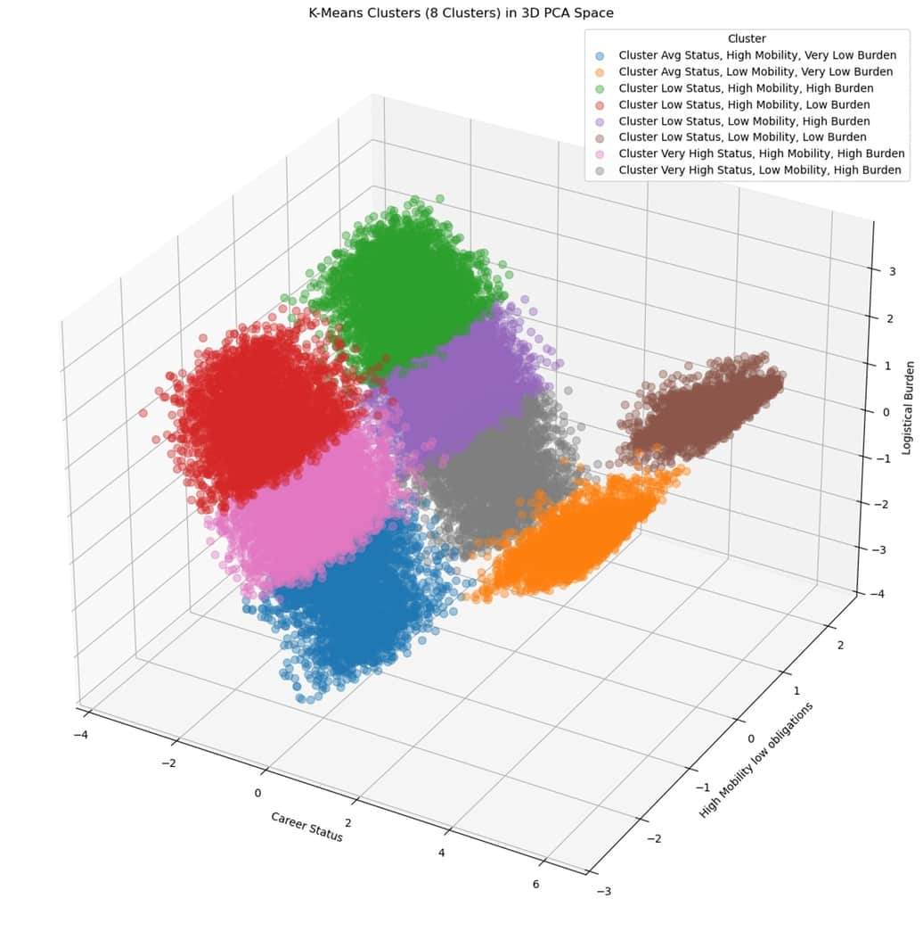
VISUALIZATON
3D VISUALIZATION FOR OUR CLUSTERS

Slide 35

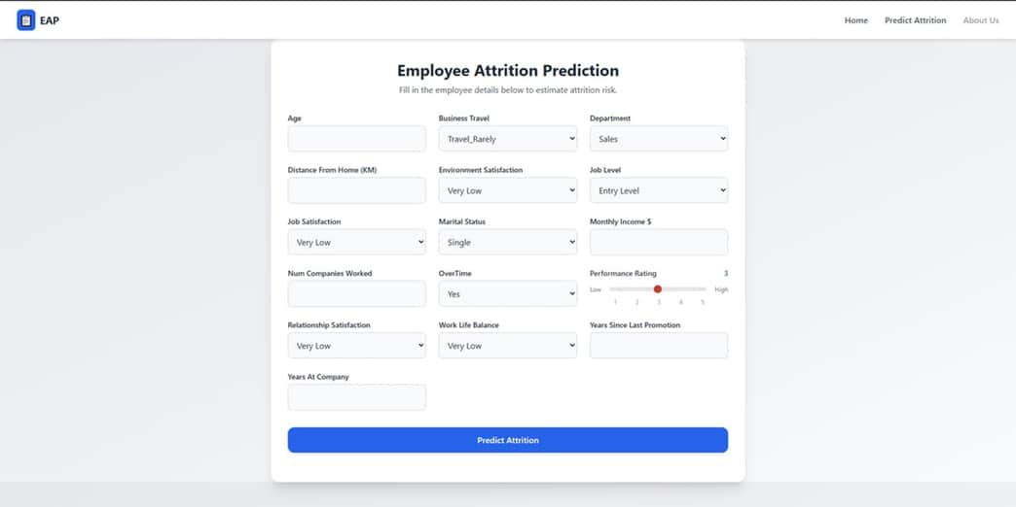
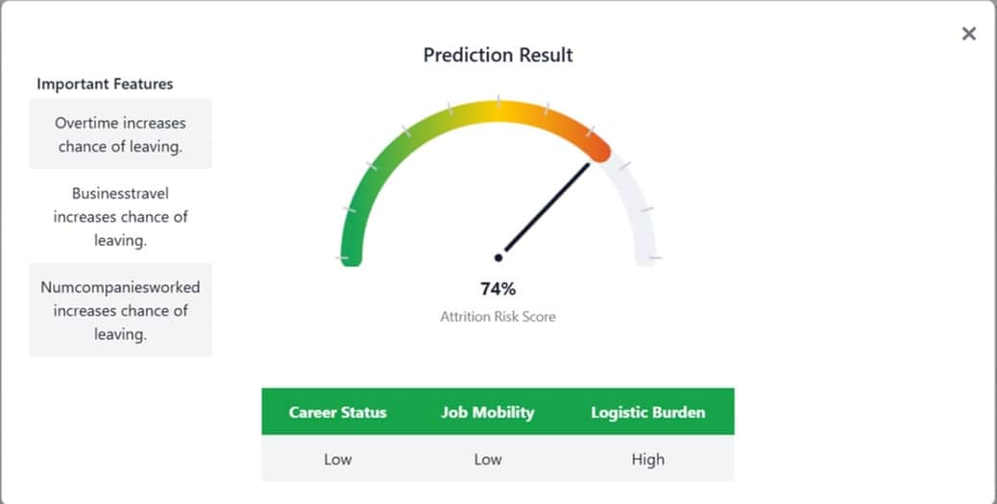
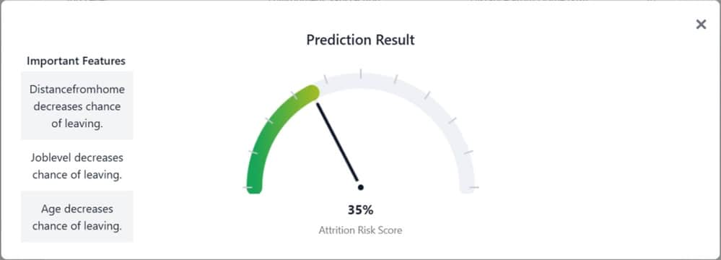
STEP 7 DEPLOYMENT

Slide 36
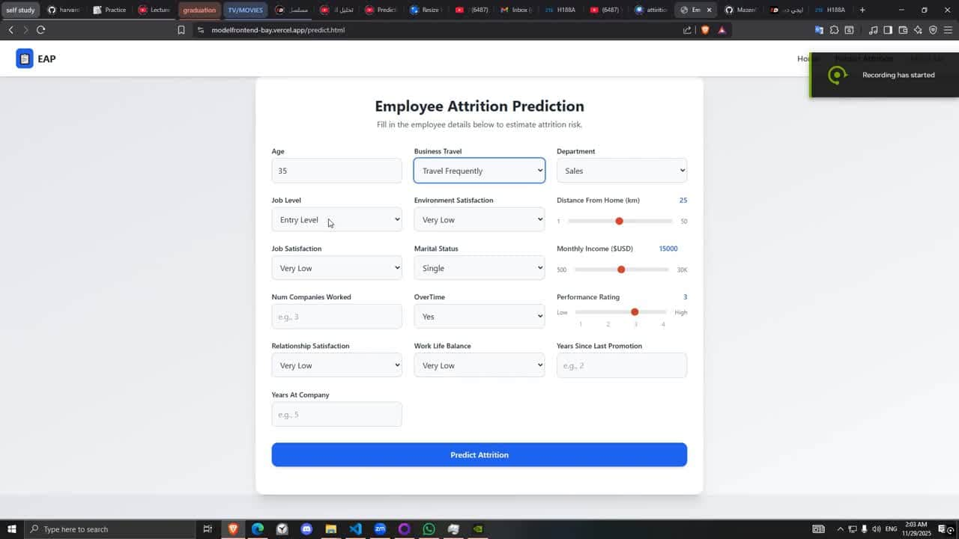
STEP 7 DEPLOYMENT DEMO

Slide 37












TOOLS PROGRAMMING LANGUAGES + FRAMEWORKS

Slide 38
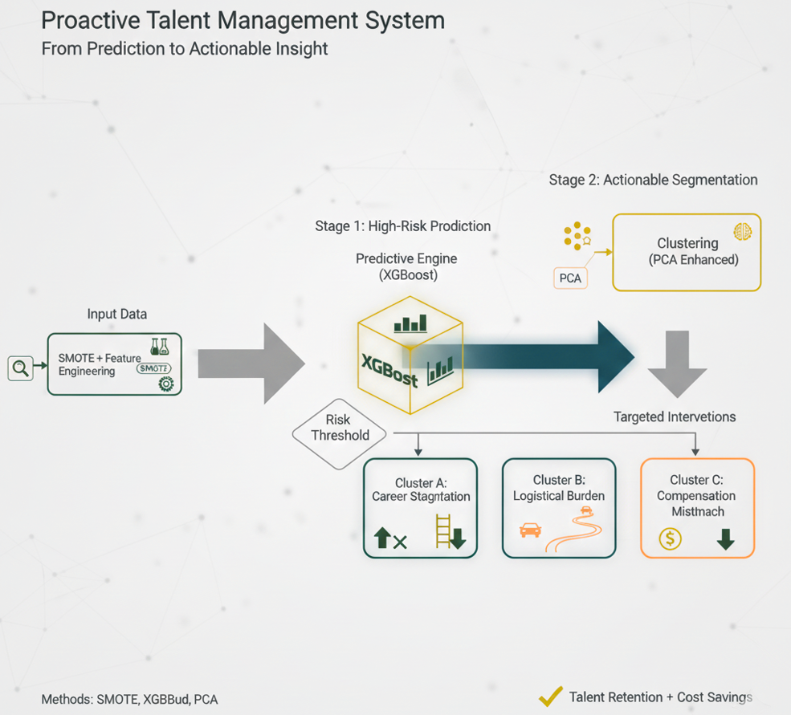
CONCLUSION
We were able to make a full Proactive attrition system that is not only detect the chance for the employee to leave but also empower the actions taken by companies to keep their talents and save their recruitments costs by using variety of machine learning methods (supervised-unsupervised) learning combined by preprocessing techniques like standardization smote gird search and PCA to achieve max performance from our models

Slide 39
prepared by
AHMED FEKRY MOHAMED
MAZEN KAMAL MORSY
1
2
YOUSIF MOAZ ELBADRY
SHAIMAA AHMED FOUAD
3
4
YOUSSEFAHMED FOUAD
5

Slide 40
Thankyou

